Slide 1


Social Buzz

Slide 2


Today's agenda
Project recap
Problem
The Analytics team
Process
Insights
Summary

Slide 3

Social Buzz is a fast-growing social media unicorn that needs to scale rapidly.
Accenture has begun a 3 months initial engagement to:
Audit their big data practice
Provide recommendations for a successful IPO
Analyse of their content categories that highlights the top 5 categories with the largest aggregate popularity
Project Recap

Slide 4

Problem
Users post over 100,000 pieces of content every day
With tens of millions of posts and hundreds of millions of users, how do you capitalize?

Slide 5



Andrew Fleming
Chief Technical Architect
The Analytics team
Marcus Rompton
Senior Data Expert
Advait Chavan
Data Analyst

Slide 6
Process
1
Data Understanding
2
Data Cleaning
3
Data Modelling
4
Data Analysis
5
Uncover Insights

Slide 7

Insights
16
Unique Category
1897
Reactions to “Animal” Posts
May
Month with most post

Slide 8
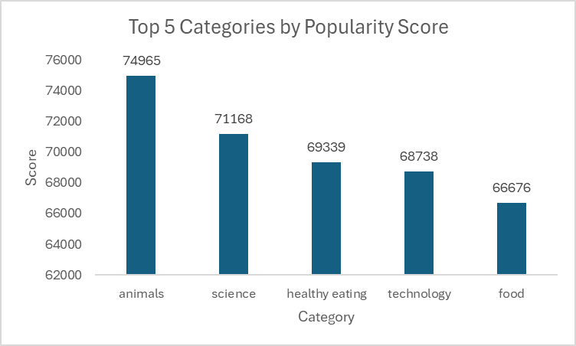

Slide 9
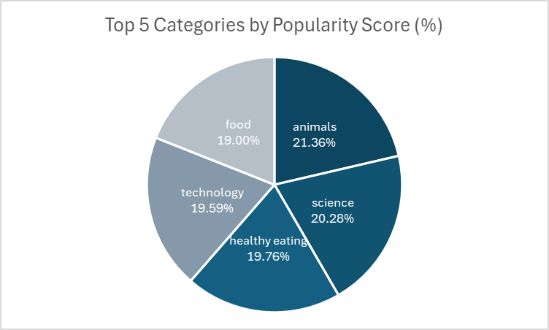

Slide 10
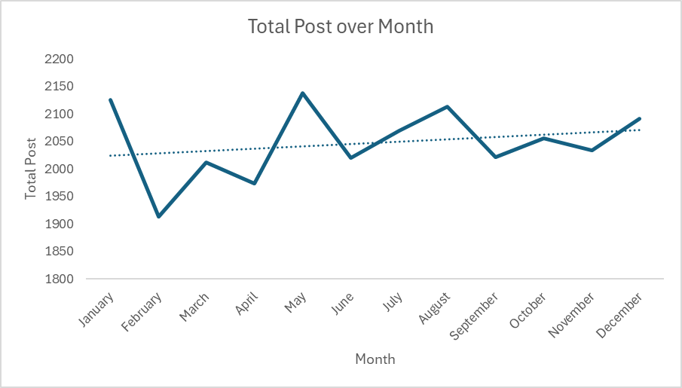

Slide 11

ANALYSIS
Animals and Science are the two most popular categories of content, showing that people enjoy “real-life” and factual” content the most.
INSIGHT
Food is a common theme with the top 5 categories with “Healthy Eating” ranking the highest. This may give an indication to the audience within your user base. You could use this insight to create a campaign and work with healthy eating brands to boost user engagement.
Summary
NEXT STEPS
This ad-hoc analysis is insightful, but it is time to take this analysis into large scale production for real-time understanding of your business. We can show you how to do this.

Slide 12
Thank you!
ANY QUESTIONS?

